Slide 1
WO3196 First measurements
Date: 2019 12 31 and 2020 06 01
Measured with coax cables and sourcemeter

Slide 2
Configuration
Wire bonded to the “top row” of Hall bars, i.e. the ones with the largest amount of Pt area
Current probes attached to the pads at the ends of the row
Voltage probes attached to the pads of device #2 (1,2 in matrix index notation) as these were easiest to wire bond to

Slide 3
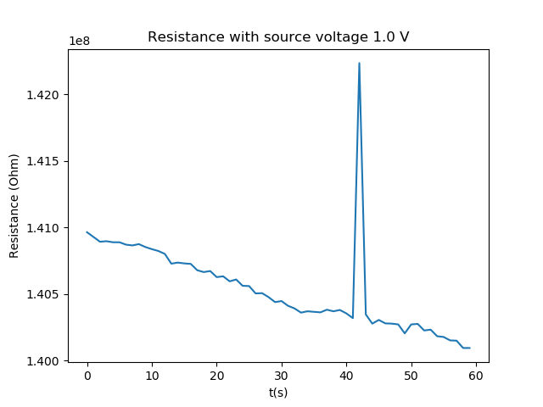
Top row measurements (test)
1231_1427_wo3196_r13
Two wire resistance measurements (voltage sourced)
No H2
Temperature setpoint is 25 C
Sample rate is 1 Hz
Measurement time is 60 s
Source voltage is 1.0 V
Limit current starts at 1.5e-08 A
Mean resistance is 1.41E+08 with std 3.34E+05

Slide 4
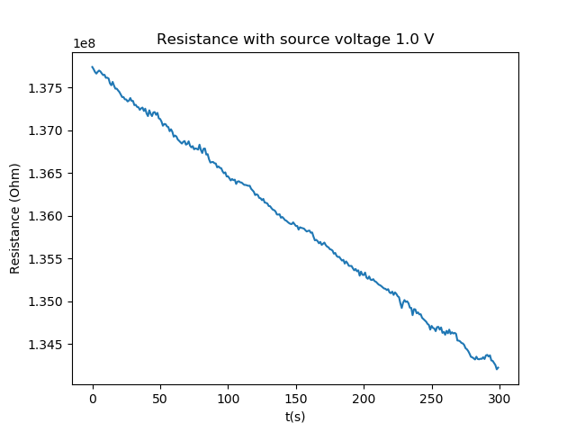
Top row measurements (5 min)
1231_1431_wo3196_r13
Temperature setpoint is 25 C
Sample rate is 1 Hz
Measurement time is 300 s
Source voltage is 1.0 V
Limit current starts at 1.5e-08 A
Mean resistance is 1.36E+08 with std 1.02E+06

Slide 5
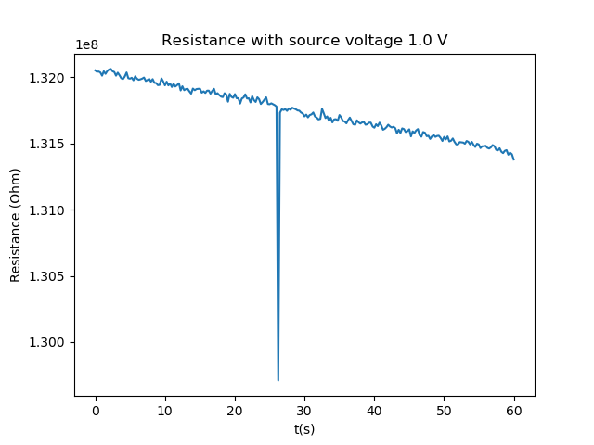
Top row measurements (10 Hz)
1231_1439_wo3196_r13
Same settings except for sample rate, which is now 10 Hz instead of 1 Hz
Temperature setpoint is 25 C
Sample rate is 10 Hz
Measurement time is 60 s
Source voltage is 1.0 V
Limit current starts at 1.5e-08 A
Mean resistance is 1.32E+08 with std 2.24E+05

Slide 6
Device #2 – Different configurations
Current sourced (only way to measure Hall bar as voltage source setup creates short)
Backward
Forward
V+
V-
V-
V+
I+
I-
I+
I-
Device
Device

Slide 7
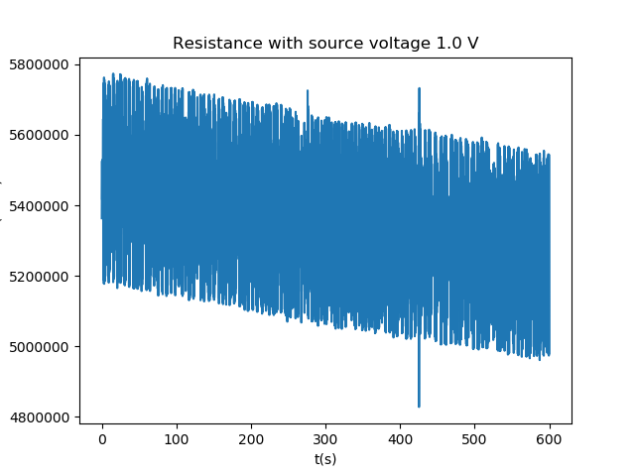

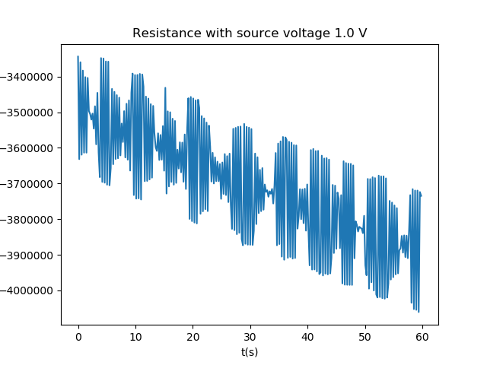
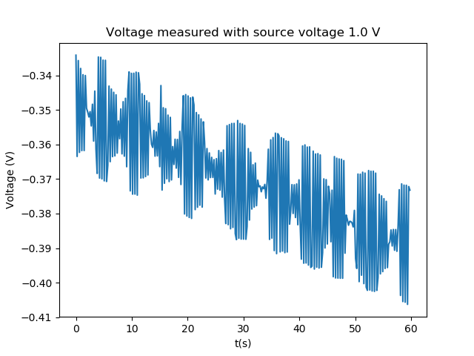
Device #2 – Different configurations
Forward and backward configs have around the same noise (2E5 Ohm std)
Measured resistance is way different.
Forward measures 5.36E6 and backwards -3.70E6 Ohm.
As forward is the default, I trust it more and will use that for the rest of the measurements
Forwards: Std = 0.021658 V
Backwards: Std = 0.017153 V

Slide 8
Device 2 – H2 and Air
First measurement has full H2 introduced around 60s in. Before it was in air, right before in vacuum.
Second and third measurements were directly after the first and the sample was continuously exposed to full H2

Slide 9
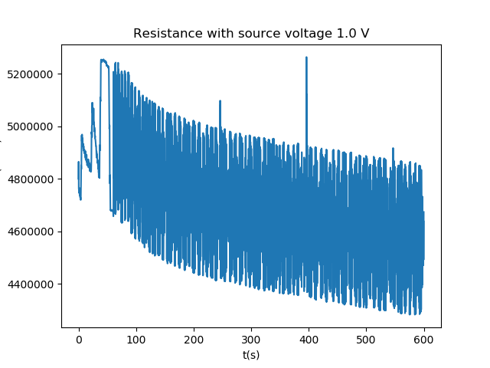
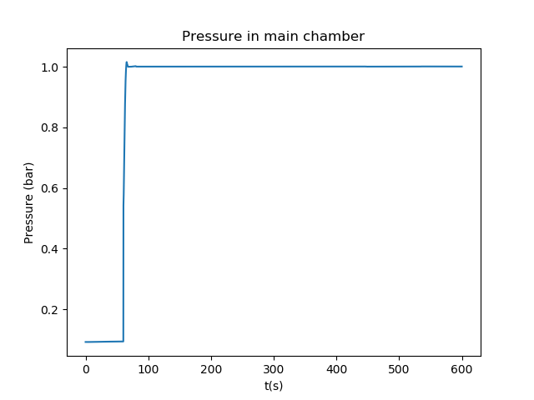
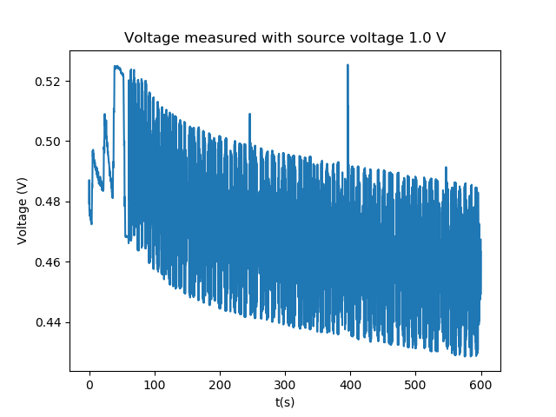
Device 2 – H2 and Air
Response to H2 is small and slow compared to first measurement.
Also the response is very hard to see due to all the noise in the data. (Might be reduced with higher source current, as this can be increased as long as the voltage reaches 10V)
V=IR

Slide 10
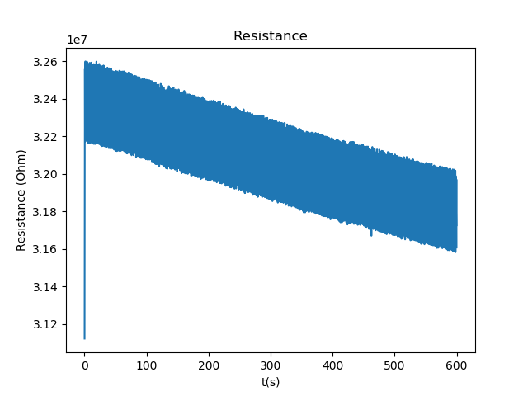
Device 2 – H2 and Air
New measurement in air has a 10x higher resistance compared to in the configuration measurements (3.2E7 vs 5.5E6)
The std of voltage noise is the same, thus the measurement with higher R is more accurate
1231_1456_wo3196_dev2_Isource_forward_resistance
0106_1430_wo3196_dev2_air_resistance

Slide 11
WO3196 Noise
For current sourcing, the voltage noise seems constant for the same source current across all measurements.
As the resistance of the device decreases the voltage across it decreases and therefore the signal becomes more noisy. This makes it hard to measure the response of the device as the measured voltage comes close in amplitude to the noise when the device is exposed to H2.
This should not be a problem when going from air to H2, but H2 to air is hard to measure this way.
Noise analysis on source meter setup with coax cables |  | WO3196
DUT | Measurement | Source | Source value (A / V) | Mean V/I | Std V/I | Std V/I % | Mean R2 | Std R3 | Std R % 4
Device 2 | 1231_1447_wo3196_dev2_Isource_forward | I | 1.00E-07 | 5.36E-01 | 2.17E-02 | 4.04% | 5.36E+06 | 2.21E+05 | 4.12%
Device 2 | 1231_1452_wo3196_dev2_Isource_backward | I | 1.00E-07 | -3.70E-01 | 1.72E-02 | 4.64% | -3.70E+06 | 1.70E+05 | 4.59%
Top row | 1231_1431_wo3196_r13_toprow | V | 1 | 7.59117E-09 | 1.29706E-11 | 0.17% | 1.36E+08 | 1.02E+06 | 0.75%
Device 2 | 0106_1430_wo3196_dev2_air | I | 1.00E-07 | 3.21E+00 | 2.25E-02 | 0.70% | 3.21E+07 | 2.36E+05 | 0.74%
Device 2 | 1231_1524_wo3196_dev2_h2 | I | 1.00E-07 | 4.47E-01 | 2.07E-02 | 4.62% | 4.47E+06 | 2.10E+05 | 4.70%
Device 2 | 1231_1541_wo3196_dev2_h2 | I | 1.00E-07 | 1.50E-01 | 2.37E-02 | 15.76% | 1.50E+06 | 2.38E+05 | 15.82%

